Slide 1



DIGITAL LITERACY
AWARENESS INFOGRAPHY

Slide 2



What is digital literacy?
Digital literacy is the ability to use digital devices and the internet effectively.
It includes finding and understanding information online.
It involves creating and sharing digital content.
It also ensures safe and responsible use of technology.

Slide 3



What are the Useful digital tools for students ?
Learning platforms (like Google Classroom) to access notes, assignments, and classes.
Note-taking apps (like Microsoft OneNote) to organize study materials.
Search engines (like Google) to find information quickly.
Communication tools (like Zoom) for online classes and discussions.
Productivity tools (like Microsoft Word, PowerPoint) to create documents and presentations.

Slide 4


What is digital literacy’s professional online presence ?
Digital literacy and professional online presence mean using digital skills to create a positive and responsible image of yourself on the internet.
It involves sharing appropriate content, maintaining good behavior online, and protecting your privacy.
A professional online presence helps in education, networking, and future job opportunities.

Slide 5



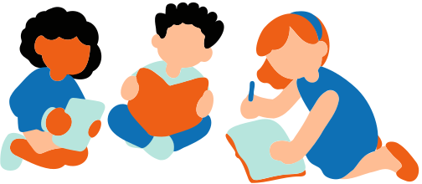
What are the Digital Literacy ?
Digital literacy email etiquette means using proper manners and professionalism while communicating through email.
It includes writing clear subject lines, using polite language, and avoiding slang.
It also involves checking grammar, responding on time, and respecting others’ privacy.

